Slide 1

软件工程专业英语
计算机科学学院
School of Computer Science
Simulated Writing: Resume

Slide 2
Overview
A resume gives prospective employers a written summary of your qualifications and work history. It convinces the reader that you are a good candidate for the position that you should be invited for an interview.
Send a resume when
applying for a franchise 特许经销权
applying for a job or internship
applying for membership in certain organization
inquiry about openings at a company
responding to an employment advertisement

Slide 3
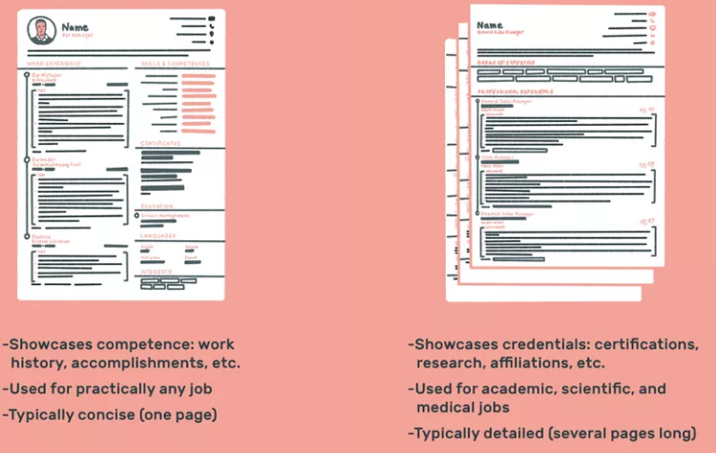
Resume VS. Curriculum Vitae (CV)
The primary differences between a resume and a curriculum vitae (CV) are length, what is included, and what each is used for.
Most resumes in the United States are competency-based: they are personal marketing documents intended to showcase the candidate’s skills, notable achievements, and work experience to the greatest advantage.
U.S. curriculum vitae, submitted for jobs in academia, scientific research, and medical fields, are credential-based, providing a comprehensive (and often lengthy) listing of one’s education, certifications, research experience, and professional affiliations and memberships.
https://www.thebalancecareers.com/cv-vs-resume-2058495

Slide 4
guidelines
limited length, usually 1-2 pages
well organized
well designed
easy to read
free of errors
use high- grade top quality paper for print

Slide 5
Analyzing Your Background
Determine what kind of job you are seeking and what information about you and your background would be most important and related to that kind of job. List the following:
Schools attended, degrees, major field of study, academic honors, grade point average (if recently graduated), particular and relevant academic projects.
Jobs held, primary and secondary duties in each of them, when and how long you held each job, promotions, skills you developed in your jobs.
Other experiences and skills you have developed that would be of value in the kind of job you are seeking; extracurricular activities that have contributed to your learning experience; leadership, interpersonal, and communication skills you have developed: any collaborative work you have performed; computer skills you have acquired.

Slide 6
Organizing Your Resume
Most resumes have information arranged chronologically in the following categories:
Heading (name and contact information)
Job Objective (optional)
Education
Employment Experience
Computer Skills (optional)
Honors and Activities
References

Slide 7
Heading
Al the top of your resume, include all of your contact information including: name, address，telephone, fax, and E-mail address. Make sure that your name stands out on the page. If you have just one address, center it at the top of the page. If you have two addresses such as school and home or temporary and permanent, place school or temporary address on the left side of the page and your permanent or home address on the right side. Place both addresses underneath your name.

Slide 8
Objective
A job objective introduces the material in a resume and helps the reader quickly understand your goal. Write your objective in three lines or less.
For example: a full-time software programmer analyst aimed at solving engineering problems.

Slide 9
Education
List the school(s) you have attended, the degrees you received and the dates you received them, your major field(s) of study, and any academic honor you have earned. Include your grade point average only if it is 3.0 or higher. List courses only if they are unusually impressive or if your resume is otherwise sparse.

Slide 10
Employment Experience
You can organize your employment experience chronologically, starting with your most recent job and working backward under a single major heading called “Experience", or you could also organize your experience functionally by clustering similar types of jobs into one or several sections with specific headings such as “Management Experience" or "Major Accomplishments".
Include jobs or internships when they relate directly to the position you are seeking.
Include extracurricular experiences, especially those involving a leadership position or community-service.
Under each job or experience, provide a concise description of your primary and secondary responsibilities.
Use action verbs with precision and conciseness. Do not use “I'”.

Slide 11
Computer Skills
If you are applying for a job that requires computer knowledge, include specific languages, software, and hardware you are familiar with.

Slide 12
Honors and Activities
If there is still room on the resume (less than 2 pages) items such as fluency in foreign languages, writing and editing abilities, specialized technical knowledge, student or community activities, professional or club memberships, and published works. Be selective; do not duplicate information given in other categories and include only information that supports your employment objective.

Slide 13
References
Unless your resume is sparse, avoid listing references. For an. interview, have a printed list of references available and bring them with you. Your list should include the main heading "References for [your name]".

Slide 14
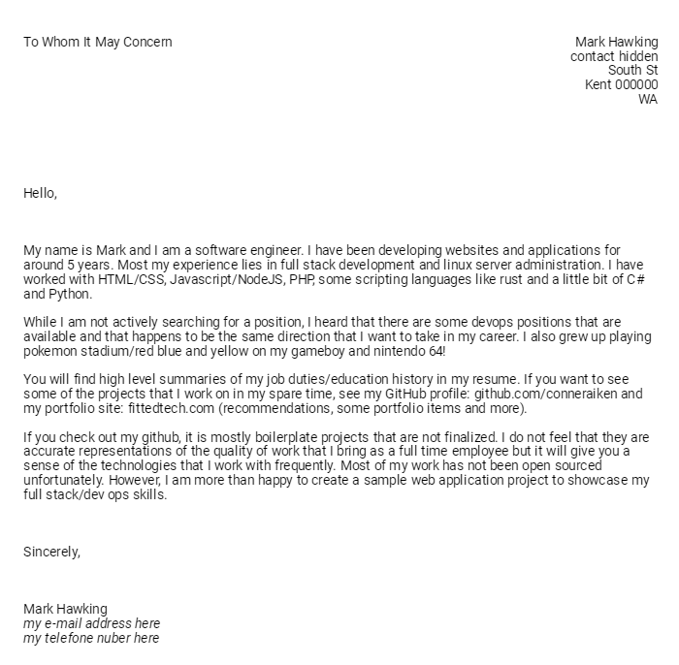
Cover Letter

Slide 15
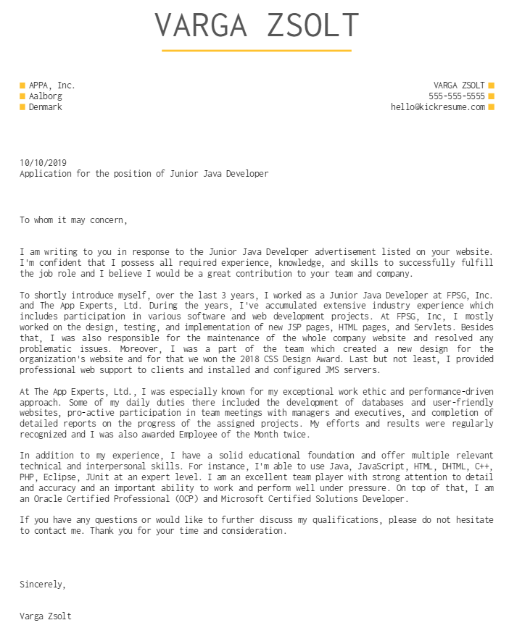

Slide 16
Samples

